Slide 1
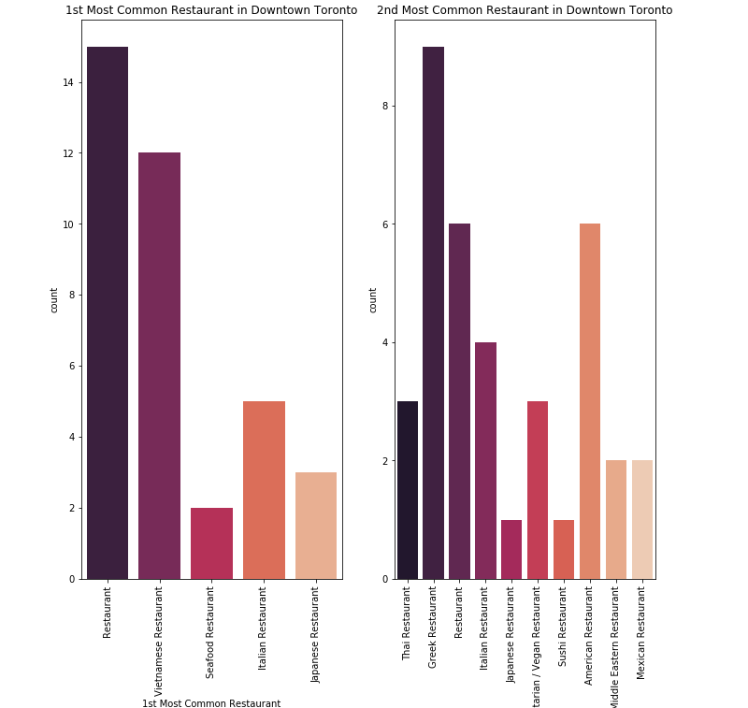
Popularity of the Restaturants by type
Plots show first and second most popular restaurants in Toronot

Slide 2
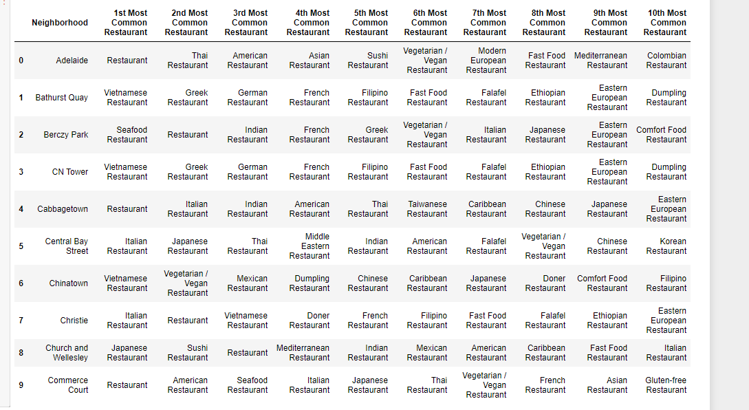
Giving Overview of Most Common Restaurants

Slide 3
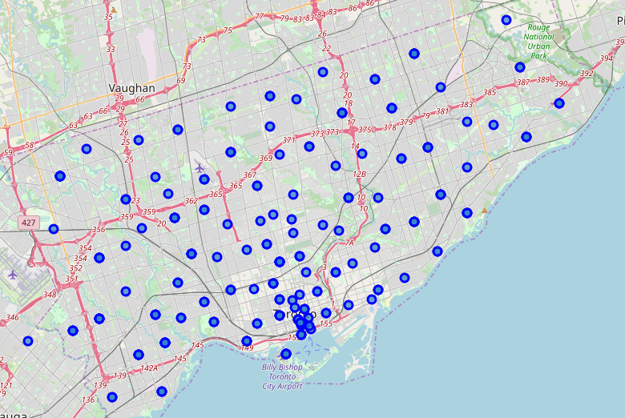
Location of Local Businesses

Slide 4
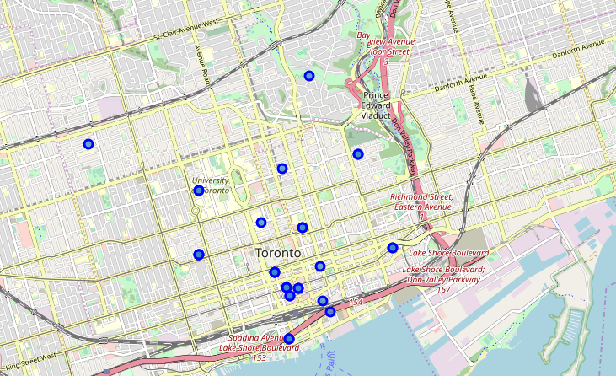
Local Restaurants before clustering

Slide 5
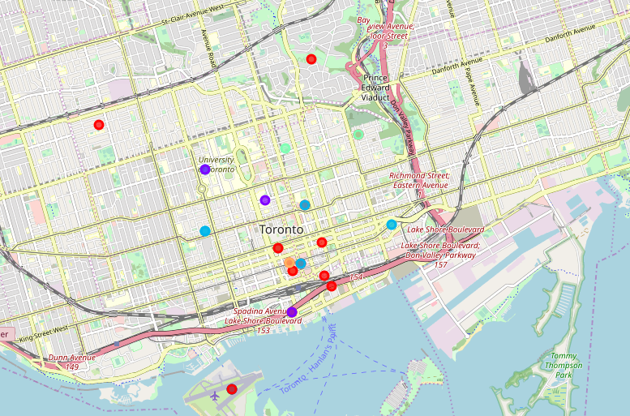
Local restraurnts After Clustering by type

